Slide 1
DeepMem: Learning Graph Neural Network Models for Fast and Robust Memory Forensic Analysis
Wei Song, Heng Yin, Chang Liu, and Dawn Song
CCS 2018

Slide 2
About paper
Problem
Identifying objects in the kernel space with deep learning
Contribution
Graph representation of raw memory
Fast and robust memory forensic analysis
Result
Achieved high precision and recall for detecting important kernel objects
Achieved high precision and recall in three different attack scenarios
Meaning
By leveraging deep learning, the proposed approach can circumvent known attacks

Slide 3
Introduction
Memory Forensic Analysis
From a memory snapshot (or dump) of a running system, extracting live digital evidence of attack footprints
…
_EPROCESS object
Process Information
…
Windows Memory Dump

Slide 4
Introduction
Memory Forensic Analysis
Signature scanning (e.g. psscan)
Identify a root object and follow the pointers defined in the objects
data structure traversal (e.g., pslist)
Scan the entire memory snapshot for objects that satisfy a unique pattern
Challenges of Memory Forensic Analysis
Expert knowledge is needed to create rules
Vulnerable to attacks manipulating data and pointer values in kernel objects (DKOM attacks)
Low efficiency

Slide 5
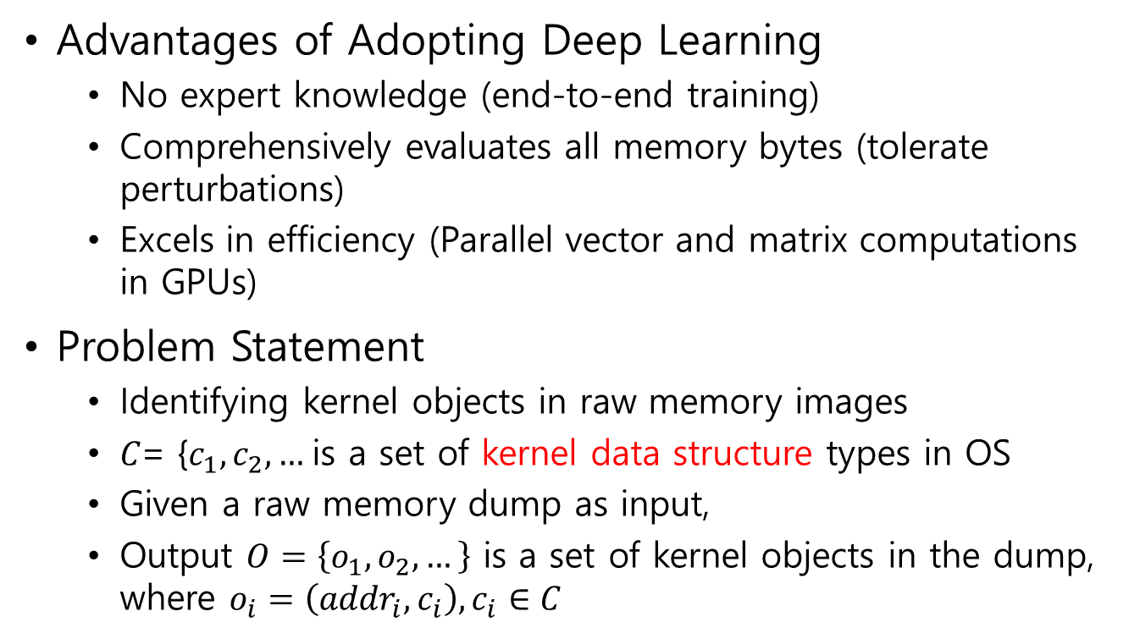
Introduction
It is dependent on the existing tool for labeling nodes.
The tool requires expert knowledge.
Advantages of Adopting Deep Learning
No expert knowledge (end-to-end training)
Comprehensively evaluates all memory bytes (tolerate perturbations)
Excels in efficiency (Parallel vector and matrix computations in GPUs)
Problem Statement
Identifying kernel objects in raw memory images
𝐶= {$c_{1},c_{2}, …$is a set of kernel data structure types in OS
Given a raw memory dump as input,
Output $O=\left\{o_{1},o_{2}, …\right\}$ is a set of kernel objects in the dump, where $o_{i}=\left({addr}_{i},c_{i}\right),c_{i}∈C$

Slide 6
Methodology
Insight
Bottleneck is the rule-based search scheme
Rules are hard to construct in the first place
Rules cannot easily adapt to an unknown OS
Rules cannot tolerate malicious attackers that attempt to deliberately violate them
New approach should learn the intrinsic features of an object that are
stable across OS versions
resilient against malicious modification
New approach should be able to detect the objects in a scalable manner

Slide 7
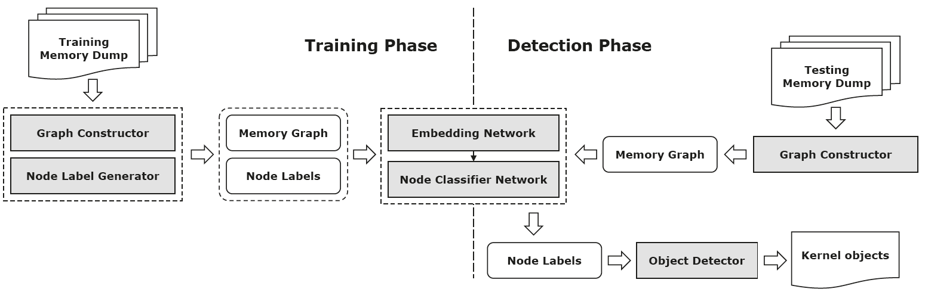
Methodology
Overview (Training Phase)

Slide 8
Methodology
Overview (Training Phase)
Deep Network

Slide 9
Methodology
Overview (Training Phase)

Slide 10
Methodology
Overview (Training Phase)
Deep Network

Slide 11
Methodology
Overview (Training Phase)

Slide 12
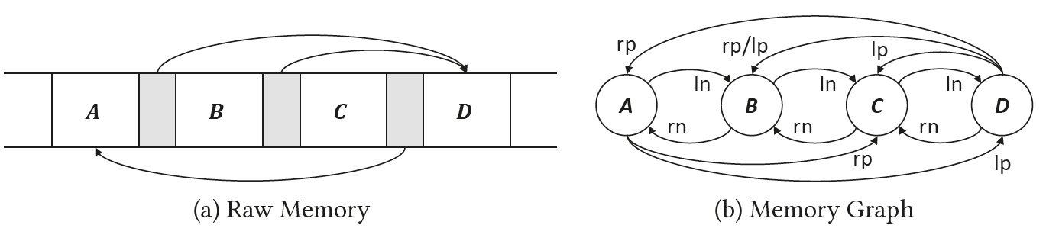

Methodology
Memory Graph
A directed graph $G=(N, E_{ln}, E_{rn}, E_{lp},E_{rp})$
Each node represents a segment of contiguous memory bytes between two pointer fields
Each edge represents either an adjacency or points-to relation between two nodes
Pointers
Nodes

Slide 13
Methodology
Memory Graph
A directed graph $G=(N, E_{ln}, E_{rn}, E_{lp},E_{rp})$
Each node represents a segment of contiguous memory bytes between two pointer fields
Each edge represents either an adjacency or points-to relation between two nodes

Slide 14
Methodology
D is pointed by a pointer on the right boundary of A
Memory Graph
A directed graph $G=(N, E_{ln}, E_{rn}, E_{lp},E_{rp})$
Each node represents a segment of contiguous memory bytes between two pointer fields
Each edge represents either an adjacency or points-to relation between two nodes
Why reverse directions to the actual point-to directions?
(Section 3.2 gives the answer, but I don’t understand)

Slide 15
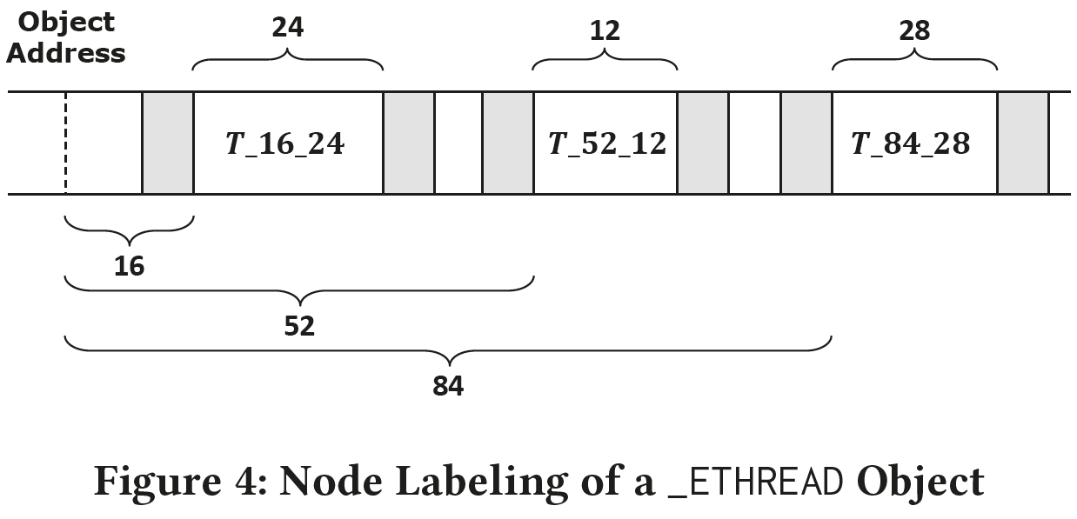
Methodology
Node Labeling
Note that an object may consist of multiple nodes
Utilize Volatility to find out the offset and length information of 6 kernel object types
If the node falls into the range of any kernel objects, give the node a label
Node label consists of 3-tuple of the object type, offset, and length

Slide 16
Methodology
Node Labeling
Select the top 20 most frequent node labels across all kernel objects of type c as key node label set L(c) for type c
Label rest of them as none

Slide 17
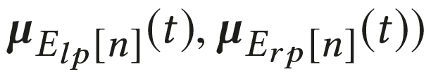
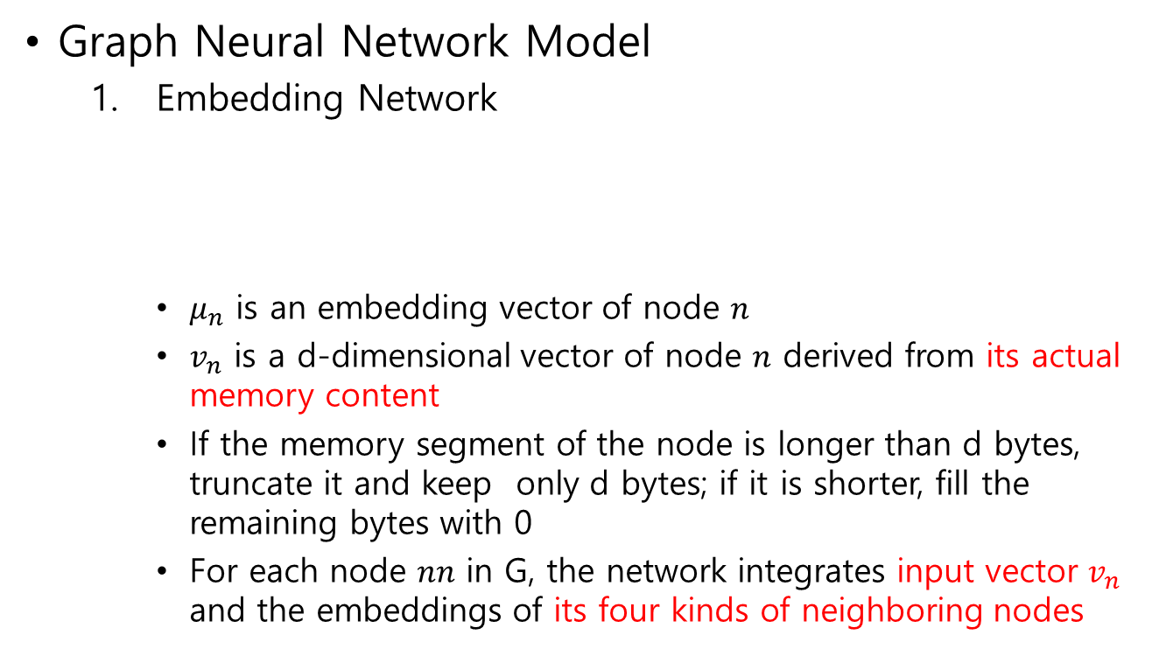
Methodology
Graph Neural Network Model
Embedding Network
$μ_{n}$ is an embedding vector of node 𝑛
$v_{n}$ is a d-dimensional vector of node 𝑛 derived from its actual memory content
If the memory segment of the node is longer than d bytes, truncate it and keep only d bytes; if it is shorter, fill the remaining bytes with 0
For each node 𝑛𝑛 in G, the network integrates input vector $v_{n}$ and the embeddings of its four kinds of neighboring nodes

Slide 18
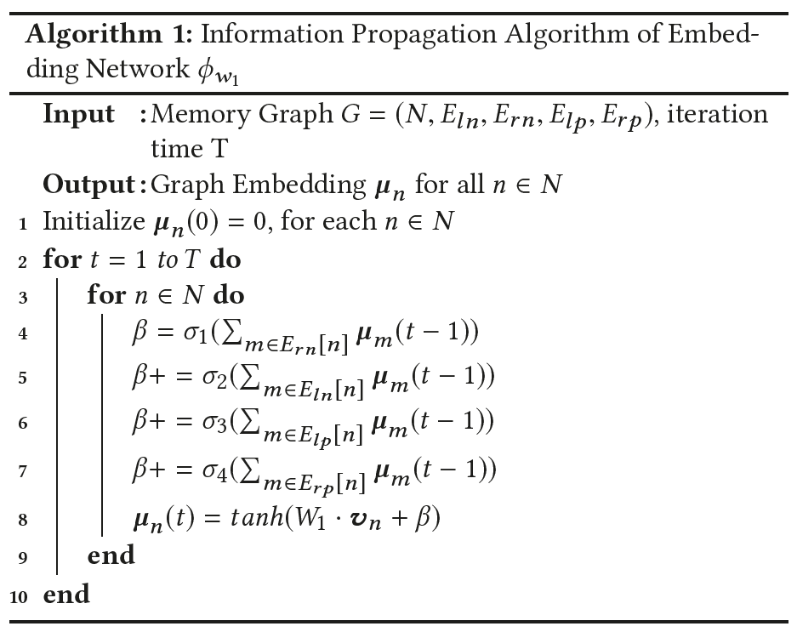
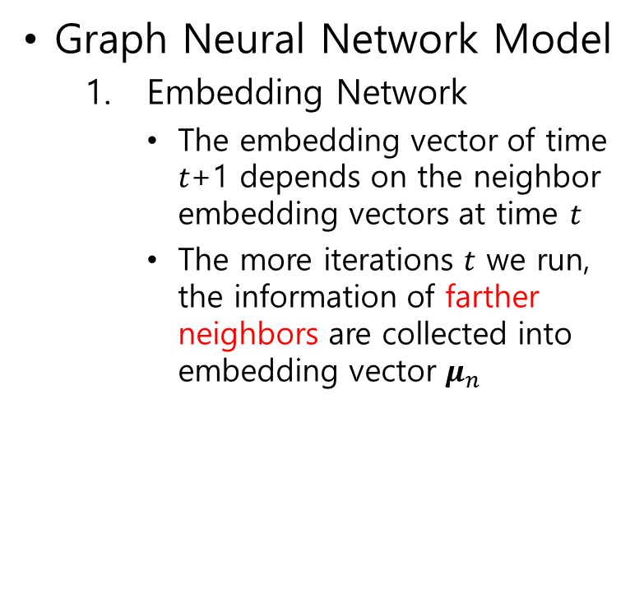
Methodology
Graph Neural Network Model
Embedding Network
The embedding vector of time 𝑡+1 depends on the neighbor embedding vectors at time 𝑡
The more iterations 𝑡 we run, the information of farther neighbors are collected into embedding vector $μ_{n}$

Slide 19
Methodology
Graph Neural Network Model
Classifier Network
Node classifier network is used to map embedding vector to a node label
With node labels of each object type, build a multi-class classifier to classify the nodes into one of the labels in that object type
There will be a classifier network for each object type
Need to train multiple classifiers

Slide 20
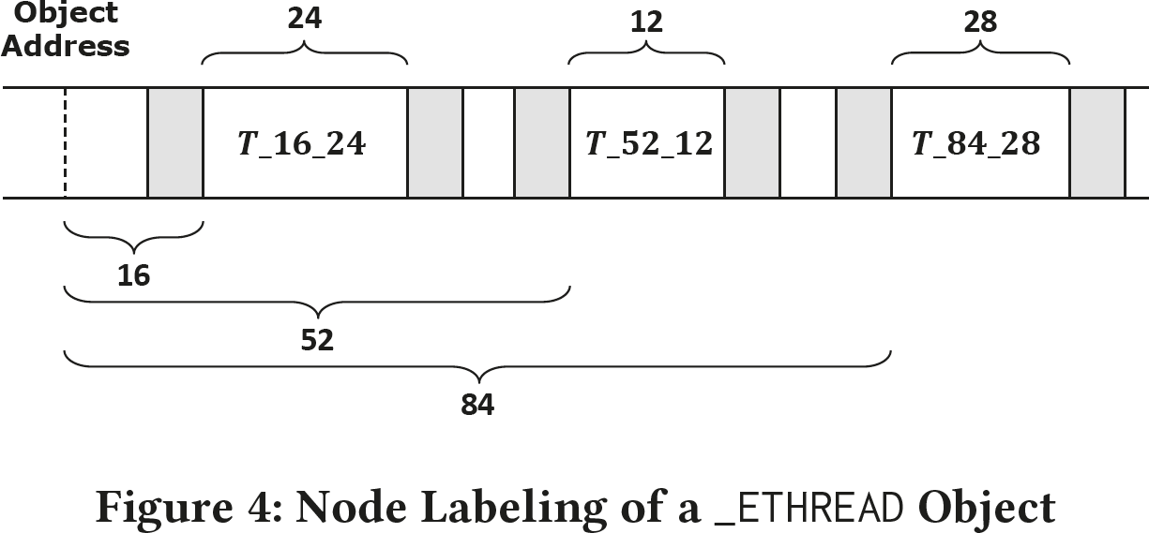
Methodology
Object Detection
If several nodes indicate that there exists an object of certain type c at the same address s in the memory dump, we can conclude that it is true
Each node in the memory indicates the presence of an object
With all the node labels, we can generate a set of candidate object addresses and corresponding voters for each address

Slide 21
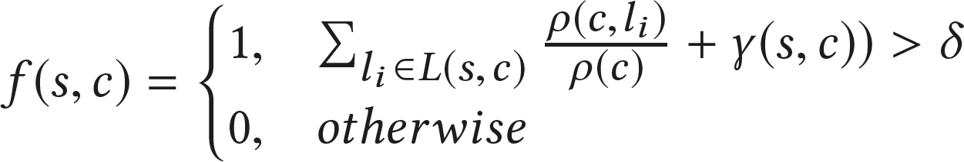
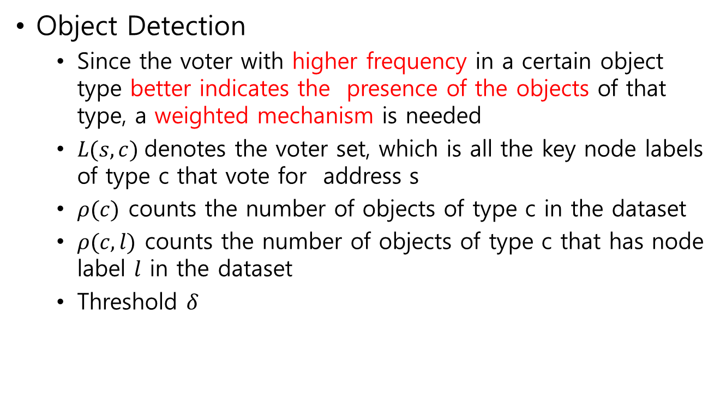
Methodology
Object Detection
Since the voter with higher frequency in a certain object type better indicates the presence of the objects of that type, a weighted mechanism is needed
$L(s,c)$denotes the voter set, which is all the key node labels of type c that vote for address s
$ρ(c)$ counts the number of objects of type c in the dataset
$ρ(c,l)$ counts the number of objects of type c that has node label $l$ in the dataset
Threshold $δ$

Slide 22
Methodology
Object Detection
Since the voter with higher frequency in a certain object type better indicates the presence of the objects of that type, a weighted mechanism is needed
$L(s,c)$denotes the voter set, which is all the key node labels of type c that vote for address s
$ρ(c)$ counts the number of objects of type c in the dataset
$ρ(c,l)$ counts the number of objects of type c that has node label $l$ in the dataset
Threshold $δ$
The weights of node label 𝒍 in predicting objects of type 𝒄

Slide 23
Methodology
Object Detection
Since the voter with higher frequency in a certain object type better indicates the presence of the objects of that type, a weighted mechanism is needed
$L(s,c)$denotes the voter set, which is all the key node labels of type c that vote for address s
$ρ(c)$ counts the number of objects of type c in the dataset
$ρ(c,l)$ counts the number of objects of type c that has node label $l$ in the dataset
Threshold $δ$
Small weights from multiple voters vs. A large weight from a single voter?
Reward the addresses voted by multiple voters

Slide 24
Evaluation
Dataset
Memory Dumps Collection
Windows 7 SP1 virtual machine in the VirutalBox
OS automatically starts 20 to 40 random actions
After 2 minutes, dumps the memory of the guest system
Collects 400 memory dumps, each of which is 1GB in size
100 images as training set
10 images as validation set
the remaining images as the testing set

Slide 25
Evaluation
Dataset
Sample Balancing
The key nodes of kernel objects in the graph are sparse and not evenly distributed
Need to preserve the topologies of the key nodes in the graph after the balancing
To reduce non-key nodes, remove the nodes that are k-hops away from key nodes in the graph
To increase key nodes and balance between different node types, duplicate the key nodes to the same amount
Without sample balancing, maybe the accuracy was not that good?

Slide 26
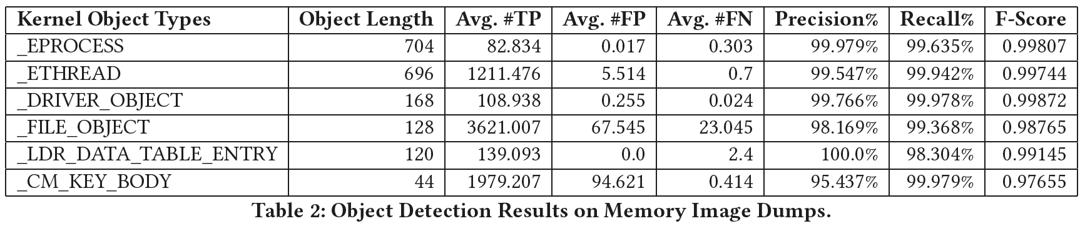
Evaluation
Detection Accuracy
High precision and recall for two important kernel object types _EPROCESS and _ETHREAD

Slide 27
Evaluation
Detection Accuracy
Larger objects achieve better recognition results
Smaller objects have fewer nodes and pointers inside them

Slide 28
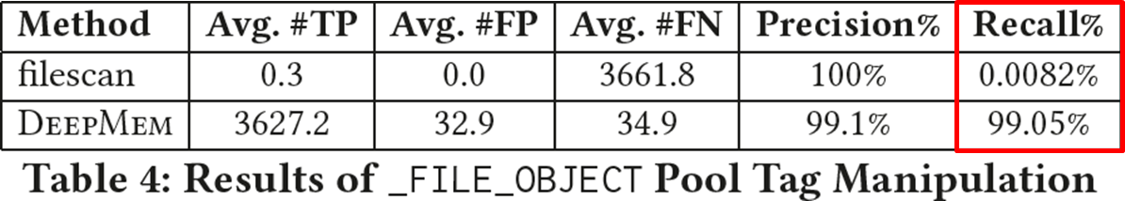
Evaluation
Robustness
Pool Tag Manipulation
Change the 4 bytes pool tags of each object to random values
Randomly select 10 memory dumps as the testing set
Take scanning _FILE_OBJECT object as an example
DeepMem examines every byte of a memory dump to detect objects
filescan relies on pool tag constraints to locate object

Slide 29
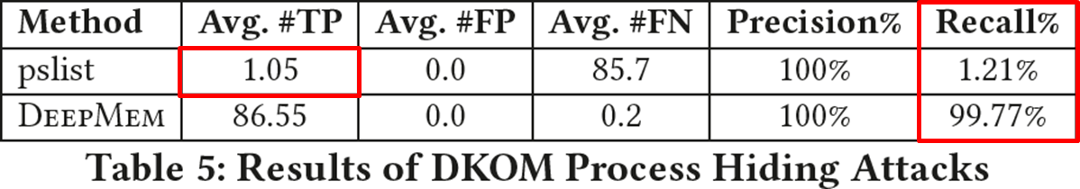
Evaluation
Robustness
DKOM Process Hiding
Change the value of the forward link field in each _EPROCESS object to random value
Randomly select 20 memory dumps as the testing set
pslist fails except the first one in each dump
pslist cannot travers through the double linked list to find other processes

Slide 30
Evaluation
It was 10 memory dumps in the previous attack scenario
Robustness
DKOM Process Hiding
Change the value of the forward link field in each _EPROCESS object to random value
Randomly select 20 memory dumps as the testing set
pslist fails except the first one in each dump
pslist cannot travers through the double linked list to find other processes

Slide 31
Evaluation
Robustness
DKOM Process Hiding
Change the value of the forward link field in each _EPROCESS object to random value
Randomly select 20 memory dumps as the testing set
pslist fails except the first one in each dump
pslist cannot travers through the double linked list to find other processes
These are meaningless evaluations.
DeepMem may be also vulnerable to attacks that specifically targets it.

Slide 32
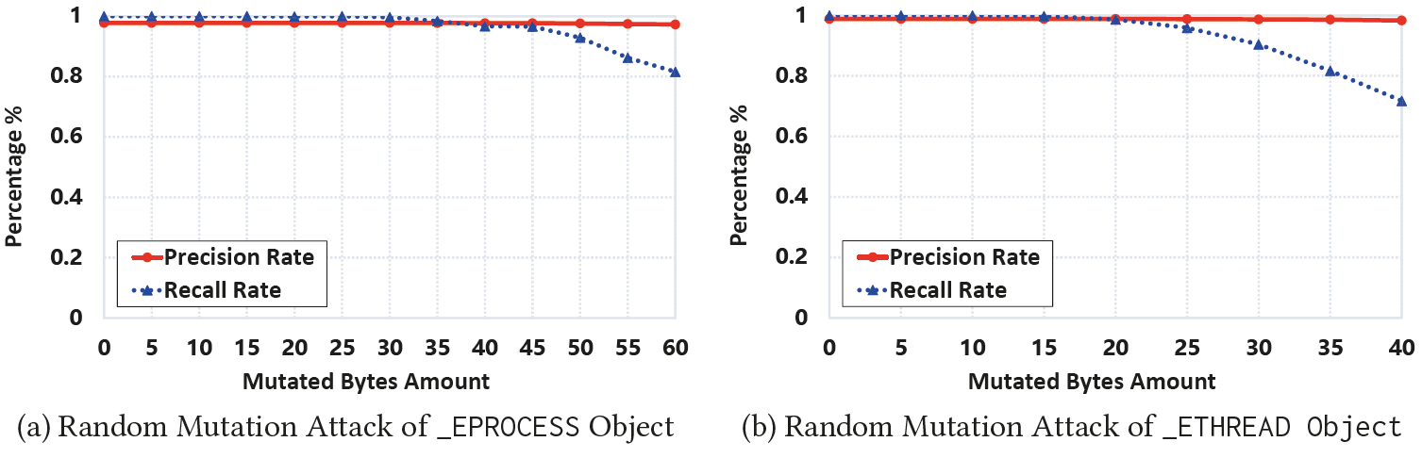
Evaluation
Robustness
Random Mutation Attack
Gradually increase the number of bytes to be manipulated in random positions of kernel objects
Need to lower the prediction threshold 𝛿

Slide 33
Evaluation
Robustness
Random Mutation Attack
Gradually increase the number of bytes to be manipulated in random positions of kernel objects
Need to lower the prediction threshold 𝛿
In real world, we don’t know this is time to lower the threshold,
because we don’t know under which attack scenario we are.

Slide 34
Evaluation
Robustness
Random Mutation Attack
The neural networks inherently tolerates small mutations due to robust features it learns from the training set
Even when deep model fails, the remaining nodes can make cross-validation and collectively conclude the presence of an object

Slide 35
Evaluation
Robustness
Random Mutation Attack
The neural networks inherently tolerates small mutations due to robust features it learns from the training set
Even when deep model fails, the remaining nodes can make cross-validation and collectively conclude the presence of an object
This is more meaningful than previous evaluations
in that it is not targeting specific attack,
but no comparison with other tools is given in this case.
Unlike the previous evaluations, even the testing set size is not given

Slide 36
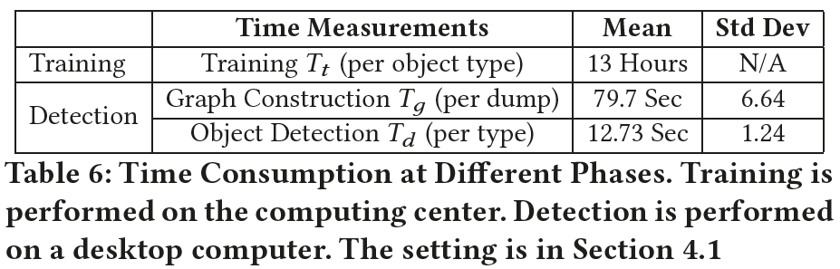
Evaluation
Efficiency
Training time with GPU
Graph construction time and object detection time without GPU
The authors should have compared it with other tools to show the efficiency.
The training time is also an overhead.
We may need to consider both the training and detection time

Slide 37
Summary
The authors suggested graph neural network model to identify kernel objects from memory dumps
The authors claim that DeepMem is better than existing tools in accuracy, robustness, and efficiency.
The evaluations are not well designed enough to support what the authors claim

Slide 38
Questions

